Slide 1

Travel Agency Website Proposal

Slide 2

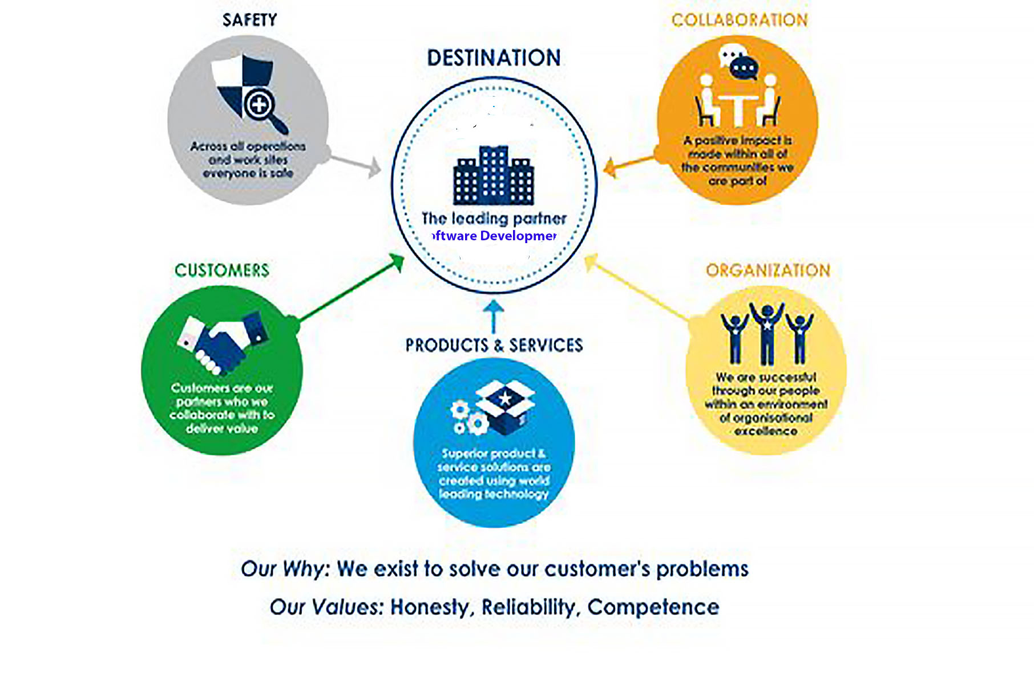
Company Information (PAS Software Development Inc)
Notes:
We are a website development company primarily specializing in utilizing HTML, CSS and Javascript to create modern, attractive and interactive websites for a variety of clients.
We tailor our products and services specifically for each client to meet their needs and requirements. We do our best to understand the business needs for each of our clients and how we can serve them best.

Slide 3
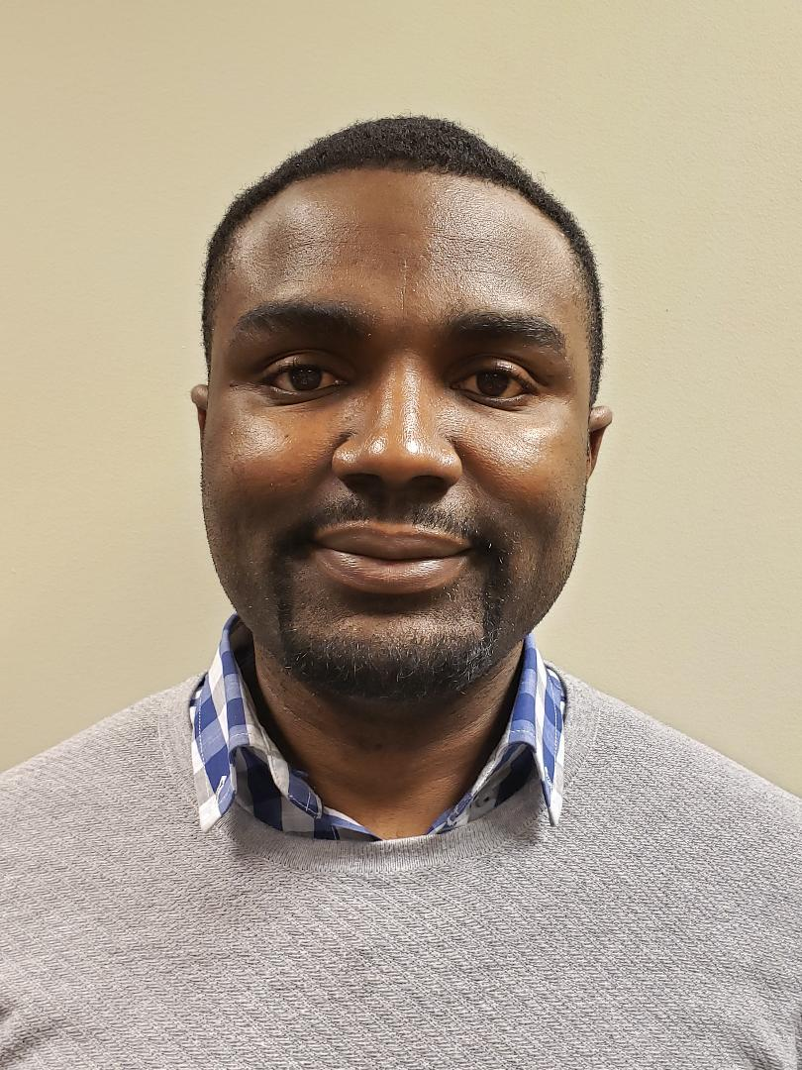
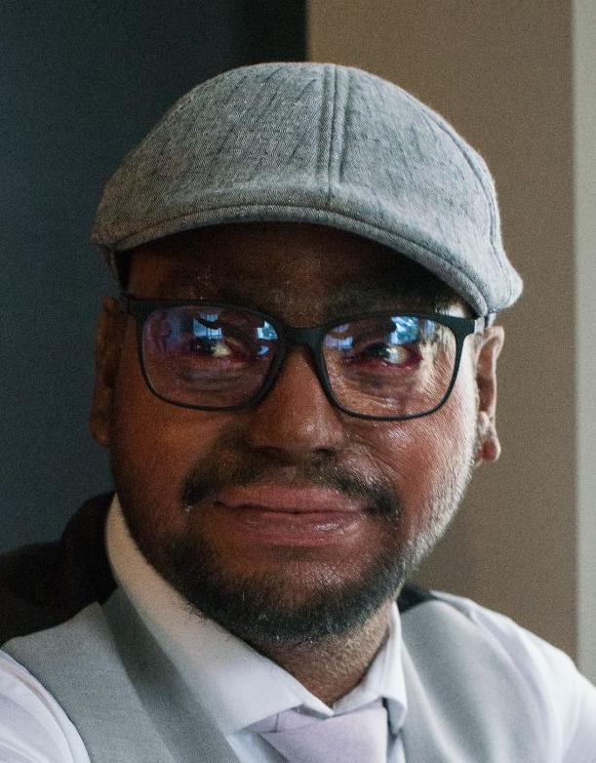

Team Information
Seyi Idowu
Philip Abraham
Alan Chok
Notes:
Seyi Idowu is our Project Coordinator with over 10 years experience in developing websites for both small and big businesses.
Philip is our Technical director with over 5 years of corporate work experience ensuring that our technical projects goes smoothly including developing Javascript content and website design
Alan is our Creative Design Administrator with over 5 years of experience in the design industry and providing assistance to all aspect of our projects.

Slide 4
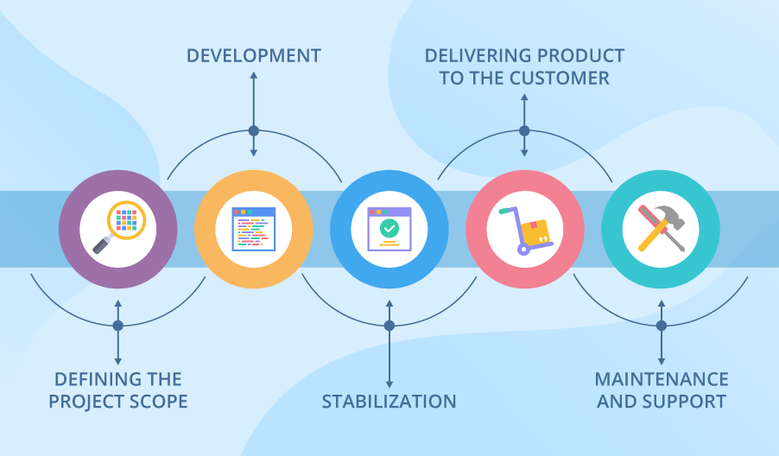
Project Scope
To provide our client a user-friendly interface to navigate throughout each page
Ability to search and display flights with specific criteria easily
We use Dynamic front end responsive preface, and backend and integrate to server database
We utilize highly advanced programming software
Upgrade client’s experiences on how they would normally use website for their travelling searches.
Notes:
Scope of the project:
To provide our client’s with a user-friendly interface to navigate throughout each page.
Ability to search and display flights with specific criteria easily by utilizing highly advanced programming software.
Upgrade client’s experiences on how they would normally use website for their travelling searches.
Initial maintenance, and keep stability and support for client.

Slide 5




Technology Used
HTML - Design the structure
CSS - Design the style
JAVASCRIPT - Add back end functionality and front end interactivity
External JS libraries - JQUERY and AnimeJS
Notes:
We used HTML to design the structure and schema of our websites including all the content such as text and pictures for each of the webpages.
We relied on CSS to implement a consistent style including font colors, background colors and font styles as well as using Flex Box and Grid for the layouts for all our webpages.
We used Javascript for all the added functionality we added to our website - rotating through pictures, text animations and page loading animations.
We also referenced two external javascript libraries for the animations - JQUERY and Anime JS.

Slide 6
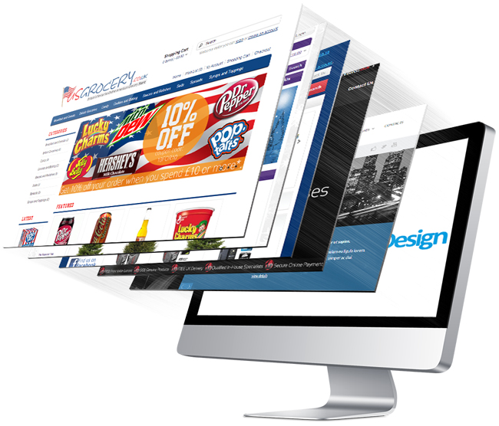
Website Design Prototype
Main Index Page
Registration Page
About Us Page
Destinations Page
Contact Page
Notes:
Main Page - contains both main index menu and a footer. The pictures are dynamic and give a preview of the destination location. The whereto go section helps to navigate only to places of interest, so as to prevent the user from seeing all posted destination pages.
Registration Page - takes relevant information from the user and store it in the database.
About Us Page - Displays information about the travel agency and travel agents
Destinations Page - Displays all the destinations we offer travel to with information
Contact Page - Provision for customers to contact us and send inquiries

Slide 7
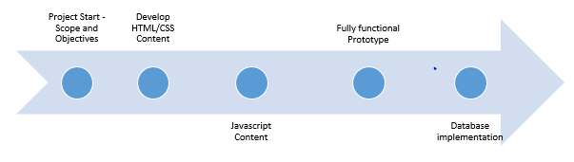
Travel Expert Website Schedule
Milestone 1 - Project Start - Define project scope and objectives - Feb 10th, 2020 - 2 days
Milestone 2 - Develop HTML and CSS Content including website structure and schema - Feb 13th, 2020 - 5 days
Milestone 3 - Develop Javascript content to add user interactivity - Feb 20th, 2020 - 5 days
Milestone 4 - Develop fully functional prototype with complete web pages and links - Feb 27th, 2020 - 10 days
Milestone 5 - Enable the website to be database ready for future expansion - TBD
Notes:
These are some of the big milestones we anticipate hitting with this project. Our first milestone involves project initiation where we determine the objectives, deliverables, design and content for the website. The 2nd milestone is us developing the content for the website including implementing the layout and gathering text and images content. The 3rd milestone is adding back end functionality and some front end complexity to our website including animations and transitions. The 4th milestone is us being able to deliver a fully functional prototype to our clients. This involves ensuring a consistency in all our thematic elements, making sure all our links are working, debugging any fixes and putting the prototype through extensive user testing to determine redundancies and any weaknessess. We anticipate a 1 month turn around for us to complete the first 4 milestones for this project.

Slide 8
Project Cost Estimate
ID | Task | Hours | Resources | Dependency | Resource Hourly Rate ($) | Estimated Budget ($)
1 | New System Analysis | 48 | 2 Business Analyst |  | 80 | 7,680
2 | Project planning | 72 | 1 PMO | 1 | 75 | 5,400
3 | Website developing (codes) | 240 | 3 programmers | 2 | 110 | 79,200
4 | Server Costs |  | 2 servers | 1 | 8000/server | 16,000
5 | New System Testing | 120 | 2 QA | 3 | 70 | 16,800
6 | Deployment | 72 | 2 Data Migration | 5 | 90 | 12,960
7 | Miscellaneous |  |  |  | 10% total | 1,380.40
Total |  | 552 |  |  |  | 139,420.40
Notes:
Total estimated hours for the project is 552 hours resulting in cost of $139,420.40.

Slide 9
Project Assumptions and Constraints
That there won’t be any need to maintain the system after the warranty period has ended. Alternatively, we can provide system maintenance as a service
That the system will be run on window 64 bit operating system, else we will have to provide an update service

Slide 10
Warranty and Limitation of Liability
We provide 60 days warranty, from the date of acceptance of our software proposal.
During this time, if the software malfunctions, or doesn’t operate in any way, then we take the necessary steps to fix the issue and ensure that the software operates according to the specifications.
However, our services remain at your disposal for any future assistance.

